Slide 1
PI Pitfalls for Non-PI Lawyers Presented to the East Valley Bar Association January 17, 2025
1

Slide 2
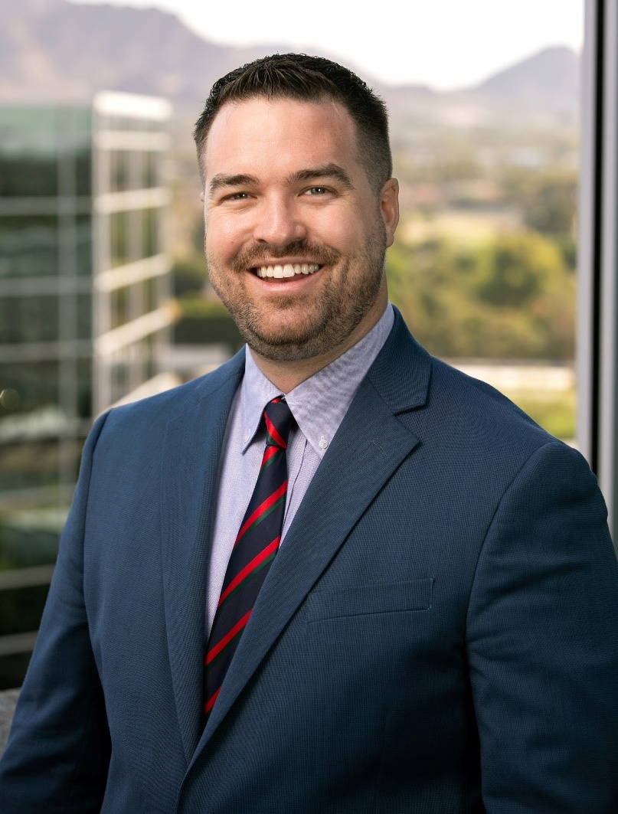
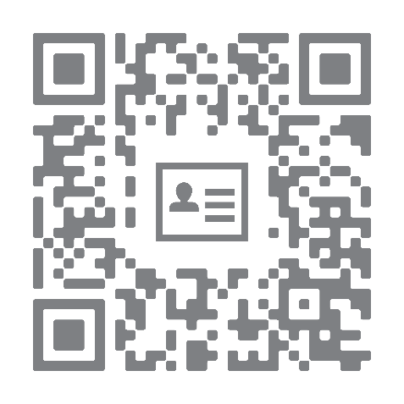
Jonathan W. Litster
jonathan.litster@gknet.com
Office: 602-530-8158
Cell: 602-751-2851

Slide 3
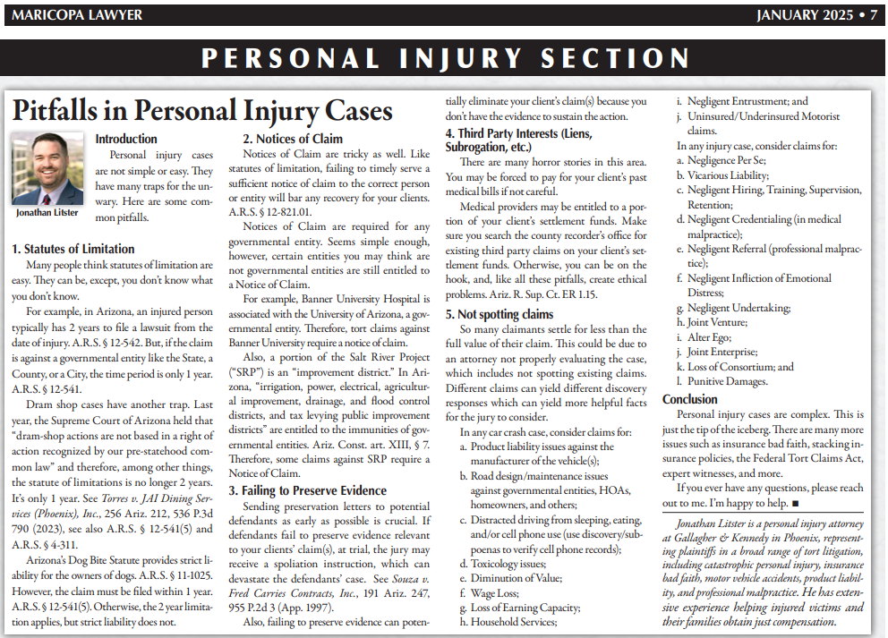
https://gknet.com/pitfalls-in-personal-injury-cases/

Slide 4
Overview
Statutes of Limitation
Notices of Claim
Letters of Preservation
Third Party Interests (Liens, Subrogation, etc.)
Spot all the claims

Slide 5
Statutes of Limitation
A.R.S. § 12-542
2 years generally
Including
Car Crashes (never say accident), torts generally (A.R.S. § 12-542(1)),
Medical malpractice (A.R.S. § 12-542(1)),
Wrongful death (A.R.S. § 12-542(2)),
Property damage (A.R.S. § 12-542(3)),
Conversion (A.R.S. § 12-542(4,5)).

Slide 6
Statutes of Limitation
Only 1 year SOL for liability created by statute!
A.R.S. § 12-541(5)
“There shall be commenced and prosecuted within one year after the cause of action accrues, and not afterward, the following action:…5. Upon a liability created by statute, other than a penalty or forfeiture.”

Slide 7
Statutes of Limitation
Therefore
Governmental Entity cases have 1-year SOLs (immunity statute)
Dram Shop cases have 1-year SOLs
Dog Bite cases have 1-year SOLs

Slide 8
Notices of Claim
A.R.S. § 12-821.01
180 days “after the cause of action accrues.”
“The claim shall contain facts sufficient to permit the public entity, public school or public employee to understand the basis on which liability is claimed.”
“The claim shall also contain a specific amount for which the claim can be settled and the facts supporting that amount.”
“A claim is…deemed denied sixty days after the filing of the claim unless the claimant is advised of the denial in writing before the expiration of sixty days.”

Slide 9
Notices of Claim
Therefore
Governmental Entities require 180-day NOCs
Banner University cases require 180-day NOCs
SRP cases can require 180-day NOCs
Valley Metro is weird. I recommend sending an NOC just in case.

Slide 10
Letters of Preservation
What
Letter telling potential defendant(s) of their obligation to preserve evidence.
Can include lists of potential evidence.
Why
Spoliation Instructions to a jury.
Preserving necessary evidence to prove your clients’ claim(s).
Products cases, distracted driving, premises, etc.

Slide 11
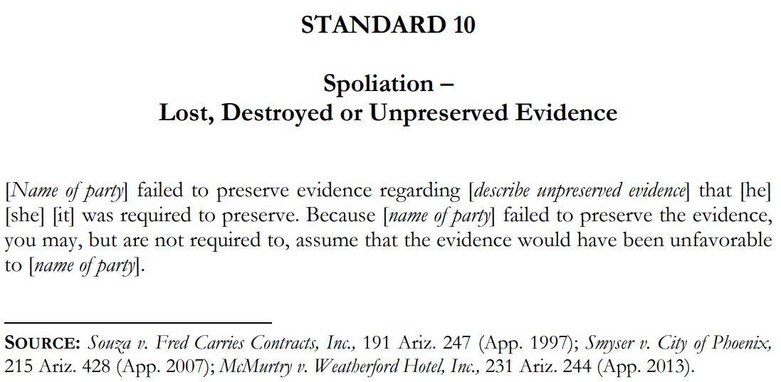
Letters of Preservation

Slide 12
Letters of Preservation
If you want an example/template of a letter of preservation, just email or text me anytime:
jonathan.litster@gknet.com
602-751-2851

Slide 13
Third Party Interests (Liens, Subrogation, etc.)
You can be on the hook for your clients’ medical bills.
Consensual Liens: Never sign it.
Liens v. Subrogation
Keep proof of your search of the County Recorder’s office.
The county where the crash occurred & where treatment was rendered.
Check out:
Third-Party Interests Handbook: Liens and Subrogation Rights by Geoffrey Trachtenberg & Justin Henry (3rd Edition).

Slide 14
Third Party Interests (Liens, Subrogation, etc.)
Examples of Third Party Interests:
Healthcare Provider Liens
State Medical Care Cost Recovery Act (“MCCRA”)
County Healthcare
Workers’ Compensation
Medical Payments Insurer Liens
Medicaid/AHCCCS
Medicare/Medicare Advantage
Employee Retirement Income Security Act (“ERISA”)
Federal Employee Health Benefits Act (“FEHBA”)
Department of Veterans Administration (“VA”) Recovery
and more…

Slide 15
Third Party Interests (Liens, Subrogation, etc.)
To summarize:
At some point you obtain settlement funds for your client.
There are laws in place that may give some third parties rights to recover from your clients’ settlement funds.
E.R. 1.15 is crucial here. You may have ethical obligations to disburse or to NOT disburse funds to certain third parties. Don’t sell your client short.
Also, if you disburse to the client, and later, a third party with a legal and valid interest to those funds comes seeking the funds, you may be obligated to pay those funds.

Slide 16
Issue Spotting in Personal Injury
Never leave money on the table.
Again…
Never leave money on the table.
One essential is to spot all the issues.

Slide 17
Issue Spotting in Personal Injury
Consider using a master list to check against every case to make sure you’re not missing anything.
Why make sure you make all potential claims?
Maximize recovery for your clients
Statutes of limitation
Notices of claim
DISCOVERY

Slide 18
Issue Spotting in Personal Injury
For ANY injury case, remember AT LEAST:
Negligence Per Se;
Vicarious Liability;
Negligent Hiring, Training, Supervision, Retention;
Negligent Credentialing (in medical malpractice);
Negligent Referral (professional malpractice);
Negligent Infliction of Emotional Distress;
Negligent Undertaking;
Joint Venture;
Alter Ego;
Joint Enterprise;
Consumer Fraud;
Loss of Consortium; and
Punitive Damages.

Slide 19
Issue Spotting in Personal Injury
For ANY car crash case, remember AT LEAST:
Product liability issues against the manufacturer of the vehicle(s);
Road design/maintenance issues against governmental entities, HOAs, homeowners, and others;
Distracted driving from sleeping, eating, and/or cell phone use (use discovery/subpoenas to verify cell phone records);
Toxicology issues;
Diminution of Value;
Wage Loss;
Loss of Earning Capacity;
Household Services;
Negligent Entrustment; and
Uninsured/Underinsured Motorist claims.

Slide 20
Hypothetical # 1
Hypo 1:
One driver, no passengers
Single car crash
Roll over
Airbags did not deploy
What information do you need; what do you need to do ASAP

Slide 21
Hypothetical # 1 (continued)
Hypo 1:
One driver, no passengers
Single car crash
Roll over
Airbags did not deploy
Secure the vehicle ASAP. This is crucial.
This is potentially a products liability case. You need to make sure the vehicle is not disposed of.
Best practice: purchase the vehicle, store it for experts to later inspect.

Slide 22
Hypothetical # 2
Hypo 2:
54-year-old male, married to a woman for 34 years
Driving vehicle he owns, he says he has car insurance, “full coverage”
Rear-ended by teenager looking at phone
What information do you need; what do you need to do ASAP

Slide 23
Hypothetical # 2 (continued)
Hypo 2:
54-year-old male, married to a woman for 34 years
Driving vehicle he owns, he says he has car insurance, “full coverage”
Rear-ended by teenager looking at phone
Preservation Letter to Defendant ASAP for phone data
Go through issues list (definitely loss of consortium)
UM/UIM issues if teenager has insufficient coverage

Slide 24
Hypothetical # 3
Hypo 3:
85-year-old female, widowed at 80, single
Driving vehicle she owns
Driving her 8-year-old grandson who was passenger in the backseat
Broadsided by someone while she was making a left turn
What information do you need; what do you need to do ASAP

Slide 25
Hypothetical # 3 (continued)
Hypo 3:
85-year-old female, widowed at 80, single
Driving vehicle she owns
Driving her 8-year-old grandson who was passenger in the backseat
Broadsided by someone while she was making a left turn
Grandma and 8-year-old have conflict (refer one out)
Go through issues list

Slide 26
Hypothetical # 4
Hypo 4:
16-year-old male, single
Driving parents’ vehicle
Rear-ended by City of Phoenix Parks and Rec truck
What information do you need; what do you need to do ASAP

Slide 27
Hypothetical # 4 (continued)
Hypo 4:
16-year-old male, single
Driving parents’ vehicle
Rear-ended by City of Phoenix Parks and Rec truck
180-day notice of claim served on City of Phoenix
1 year statute of limitations

Slide 28
Jonathan W. Litster
jonathan.litster@gknet.com
Office: 602-530-8158
Cell: 602-751-2851

